Slide 1
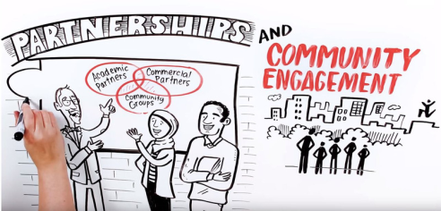
Annual Catalyst Grants
The York University TD Community Engagement Centre
2022

Slide 2
Agenda
Background and context of the CEC’s work
Purpose of the Catalyst Grant
Important Criteria
Application process
Q&A

Slide 3
Background
Opened in 2008
Aim at fostering more meaningful relationships between Jane Finch and Black Creek Community
The York University-TD Community Engagement Centre supports the University’s commitment to build a more engaged university by facilitating mutually-beneficial collaborations between York University and the Black Creek community.

Slide 4
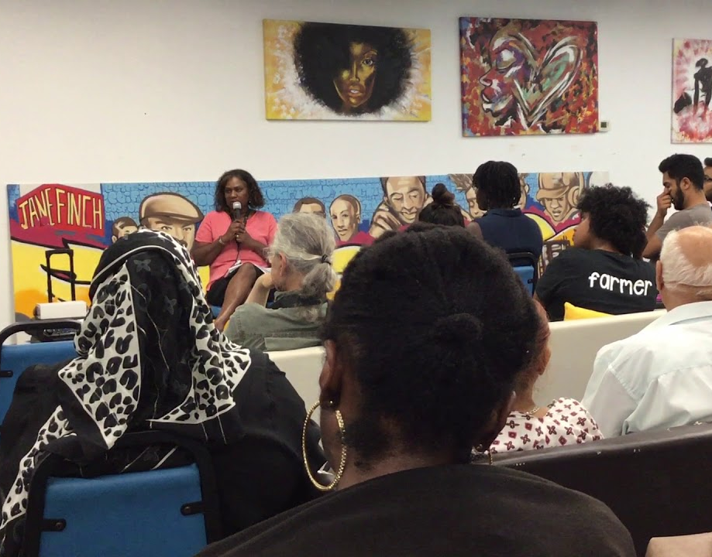
Core Areas
1. Fosters teaching and learning through experiential education opportunities that fit community needs
2. Supports access to post-secondary education
3. Enhances capacity of York faculty/students and community partners to work collaboratively on community-based research
4. Coordinate institutional structure to respond to community requests and opportunities for university-community collaborations
5. Support and outreach for reskilling, retooling & developing Opportunity for people to Thrive
Notes:
Tessa

Slide 5
Experiential Education
Traditional placements for Education, Social Work, Nursing, ACE & Communications
Community-based student orientation
Tax Clinics
Annual Work-study position
Non-profits exploring private partnerships with MBA students from Schulich School of Business
Notes:
Partnerships: connected Schulich stdnts w/ comm orgs to create slidedecks to help make connects to corporations that fit the mandates, sponsorships ~ about 2 years prior to pandemic

Slide 6
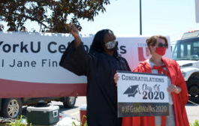
Access to Post Secondary
The First Year Network
Annual Walk with Excellence
School tours
Back to School events
Take your kids to work
In School Workshops
Women’s Bridging Program
Notes:
Talisha

Slide 7
Community Based Research
Jane Finch Community Ethics Advisory
Jane Finch Repository
Catalyst Grant: Co-Designing with Communities
Notes:
Anchor Institution: is and continues to strive to be an anchor – multiple areas of support, social procurement, local hiring, volunteerism Community of Practice – 4x/year, committee, 2.5/3ish years

Slide 8
University - Community Collaborations
Community Committees, Networks and Collaborations
The Community of Practice: Community Engagement
Anchor Institution
Notes:
Anchor Institution: is and continues to strive to be an anchor – multiple areas of support, social procurement, local hiring, volunteerism Community of Practice – 4x/year, committee, 2.5/3ish years

Slide 9
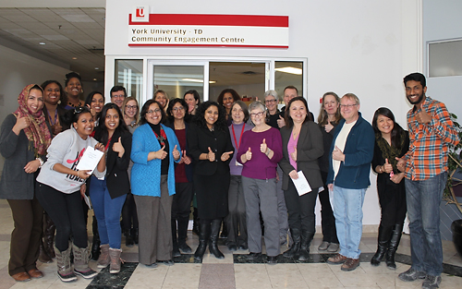
The Catalyst Grant
Existed since 2015
Over $150,000 awarded to community University Partnerships
Average funding amount = $5000
Intended as seed funding for pilot projects
Notes:
The Catalyst grant has existed for 5 years, launching in 2015 where t funded 6 community University Partnerships including a community design and planning workshop series with CAPG, A Stem rpo series and a conflict mediation program in the community.
The Catalyst grant is really designed to fund new, start up or new project. It is similar to Seed funding in that it is designed to fund new innovative projects that foster University Community Partnerships.

Slide 10
2022-2023 Theme: Sustainable Communities
Towards United Nation’s 2030 Agenda for Sustainable Development: Projects that contribute towards the targets indicated in UN Sustainable Development Goal 11: Making cities and human settlements inclusive, safe, resilient, and sustainable.
Equitable approaches to sustainability: project contribute to increasing sustainability in way that is most meaningful to the Jane Finch community, taking a multi-disciplinary justice-focused lens.

Slide 11
Where to Find the Grant
The grant application: “Call for Proposals 2022-23: Sustainable Communities” https://cec.info.yorku.ca/catalyst-grants/
This website also has examples of past grantees, videos of information sessions and other additional information
This Photo by Unknown Author is licensed under CC BY-NC
Notes:
Where to Find the Grant
The grant application https://cec.info.yorku.ca/catalyst-grants/
This website also has examples of past grantees, videos of information sessions and other additional information
Great resources if you are thinking of ideas and want some examples of past grantees, looking to better understand what grants we had
Also includes previous years information sessions.

Slide 12
What do we mean by Community University Partnerships?
Involves at least one community (Black Creek) partner working together with one York University partner
Community Partner: Any organization, non-profit, or organized resident group, or resident who resides or supports the Black Creek community
York University Partner: Faculty member, staff, long-standing student club
Partnership = More than a signature
Building together
Notes:
For us one of the major factors on if you get a grant is the level of partnership you have.
We are looking for projects that are more then just having a partner sign the application and the final report. We are looking for projects which really bridge and create partnerships.
This partnership piece is so key and we are really looking for projects which compliment each other, where you can utilize for example York resources and community expertise.
For example the JFCRP
York partners were able to talk about the processes for research at Yorku.
Another example is Launch Yu
Community members used York partners knowledge of the University structure
Continued on to receive funding

Slide 13
Finding a Partnership
If you are having trouble connecting to a Community/University Partner, book an appointment with the Community Projects Coordinator (Marierose Talla, rtalla@yorku.ca) or Manager (Byron Gray, byrong@yorku.ca) who can assist with making potential connections
Google topic
York's SDG Website: https://www.yorku.ca/unsdgs/sustainable-cities-and-communities/
Reach out to your networks
Notes:
For us one of the major factors on if you get a grant is the level of partnership you have.
We are looking for projects that are more then just having a partner sign the application and the final report. We are looking for projects which really bridge and create partnerships.
This partnership piece is so key and we are really looking for projects which compliment each other, where you can utilize for example York resources and community expertise.
For example the JFCRP
York partners were able to talk about the processes for research at Yorku.
Another example is Launch Yu
Community members used York partners knowledge of the University structure
Continued on to receive funding

Slide 14
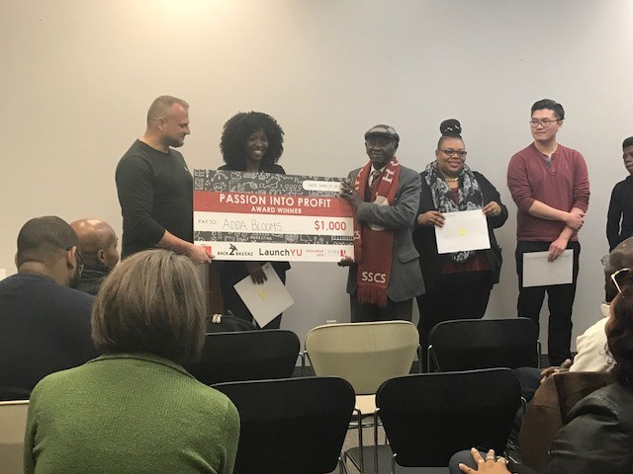
Focus on the Black Creek /Jane Finch community
Intended to serve the Black Creek Jane Finch Community in some capacity (Post Codes: M3L, M3N, M3J, M3M)
Can include youth, seniors, newcomers, any population living within the community
Notes:
For Launch Yu it was bringing resources from York into the community to support.

Slide 15
Alignment Core Areas
1. Fosters teaching and learning through experiential education opportunities that fit community needs
2. Supports access to post-secondary education
3. Enhances capacity of York faculty/students and community partners to work collaboratively on community-based research
4. Coordinate institutional structure to respond to community requests and opportunities for university-community collaborations
5. Support and outreach for reskilling, retooling & developing Opportunity for people to Thrive
Notes:
Tessa

Slide 16
The Application
5 Main sections (outlined in application) including:
Contact information of both partners
Description of project
Project Goal and Outcomes (max.300 words)
Anticipated Work plan (with key project milestones and dates)
Budget
Notes:
The Catalyst grant has existed for 5 years, launching in 2015 where t funded 6 community University Partnerships including a community design and planning workshop series with CAPG, A Stem rpo series and a conflict mediation program in the community.
The Catalyst grant is really designed to fund new, start up or new project. It is similar to Seed funding in that it is designed to fund new innovative projects that foster University Community Partnerships.

Slide 17
How & When to Submit a Proposal
Microsoft Word/PDF
3 pages maximum
Proposal should be submitted by email to rtalla@yorku.ca
DEADLINE: Monday, August 15, 2022 at 11:59pm
Notes:
All the applications will be reviewed by our Selection committee, which consists of members of the CEC’s Advisory Committee. You would hear from us by September for decisions.
We highly encourage anyone considering this grant to get in touch with us.

Slide 18
Any questions
Email: rtalla@yorku.ca & byrong@yorku.ca
Website: www.yorku.ca/cec
Twitter & Facebook : @YorkUTDCEC

