Slide 1

Barry Rieder,
Nov. 2, 2015

Slide 2
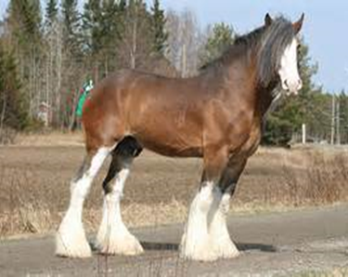
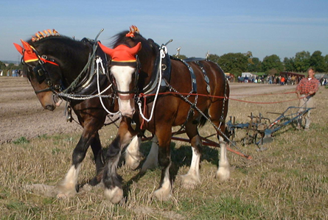
Power of working in partnership
One Clydesdale horse can pull 6 ton
When two are strapped together they can pull 36 ton

Slide 3

Community Context
Jane and Finch / Black Creek situated in the North West part of Toronto

Slide 4
Community Context
Rich in culture
70 different languages and dialects spoken & representation of over 100 nationalities
Total Population 110,972
percentage of population that are low income, require social assistance, unemployed or underemployed - 58.7%

Slide 5
Black Creek Financial Action Network
Multi-partner (local) network coordinating efforts of those providing financial information
Mounting public events with a financial focus

Slide 6
Black Creek Financial Action Network
Sharing best practices and building capacity of service providers
Researching and evaluating financial programs and services
Advocating for the community on finance matters

Slide 7
Accomplishments
Collaborative:
Financing Post-Secondary Education
(2012, 2013, 2014)
Credit Education Week Activities (2012, 2013, 2014, 2015)

Slide 8
Accomplishments
Research projects:
Youth Perspectives on Financial Literacy (2013)
Research and Workshop on Pay-Day Loans (2013)
Retiring on a Low Income (2013)
(by John Stapleton)

Slide 9
Accomplishments
Hosted :
“Sustainability of Financial Literacy in Low Income Communities” session with Financial Literacy Leaders, including Jane Rooney. (2015)
Ontario Submission:
on Pay-Day Loans to the Minister of Government and Consumer Services (2015)

Slide 10
Challenges
Keeping membership alive due to competing demands of organizations
No funding for Collaborative itself
How best to engage Banks

Slide 11
Challenges
Is financial literacy just rolling a boulder up a hill since economic health of individuals and community dependent on other systemic factors?

Slide 12
Members of BCFAN
*Afghan Women's Organization *Black Creek Community Health Centre *Black Creek Micro Lending Program *Delta Family Resource Centre *Jane Finch Family and Community Center *JVS *North York Community House *Northwood Neighbourhood Services *P.E.A.C.H. *ABC Life Literacy Canada Literacy *Canadian Centre for Financial Literacy *Credit Canada Debt Solutions *Prosper Canada *Smart Saver
*Toronto Employment and Social Services, *York University (CEC as well several faculty members from various departments)
*United Way of Toronto *Financial Consumer Agency of Canada (FCAC)
Banks: (Alterna, BM0, CIBC, Scotia, RBC, TD)

Slide 13
For More Information
Contact co-chairs:
Lorna Schwartzentruber (York University TD Community Engagement Centre) (416) 736-2100 x20349 lornas@yorku.ca
Elena Jara ( Credit Canada Debt Solutions) (416) 228-2535 ejara@creditcanada.com
http://cec.info.yorku.ca/black-creek-financial-action-network/

